Slide 1
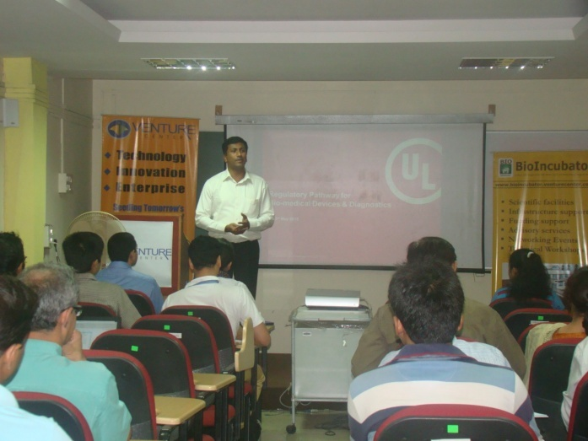
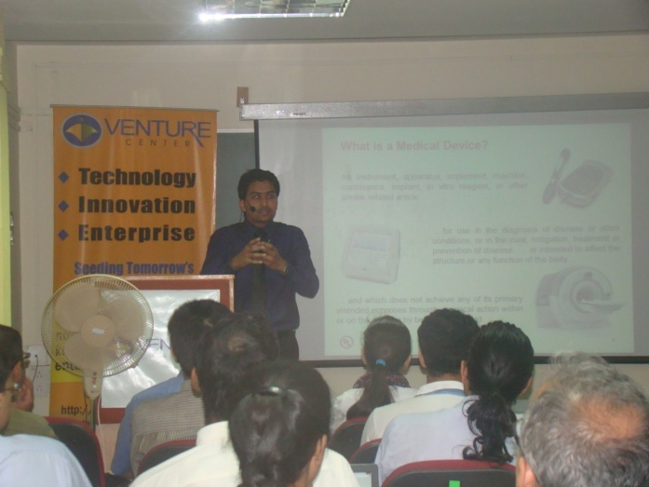
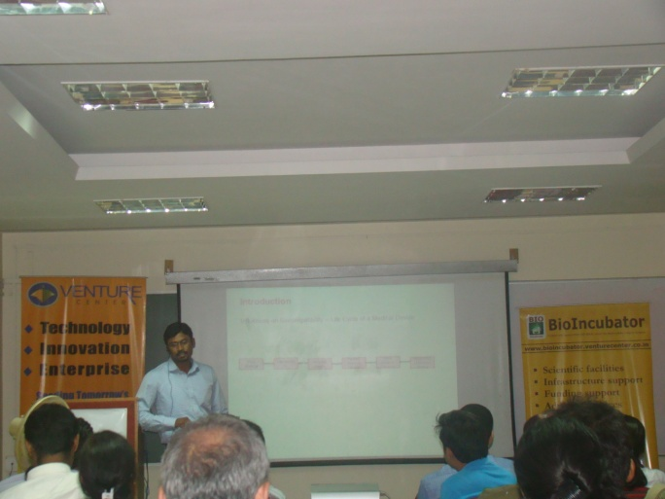
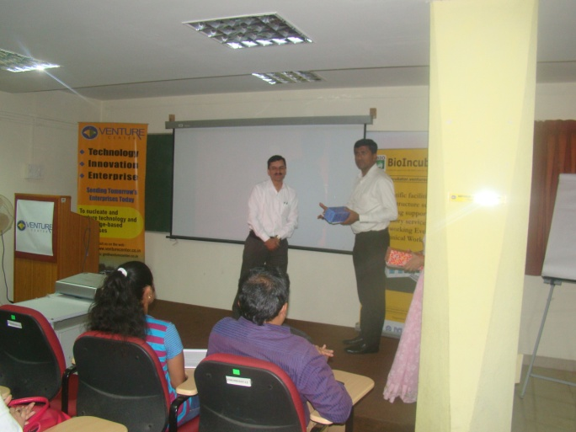
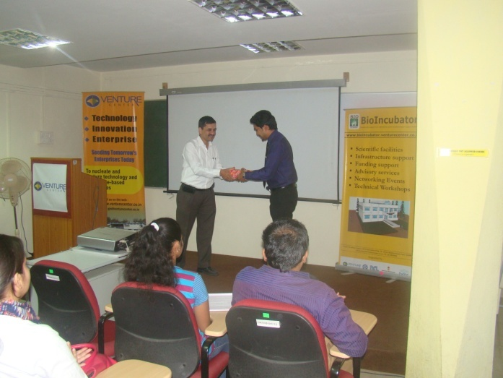
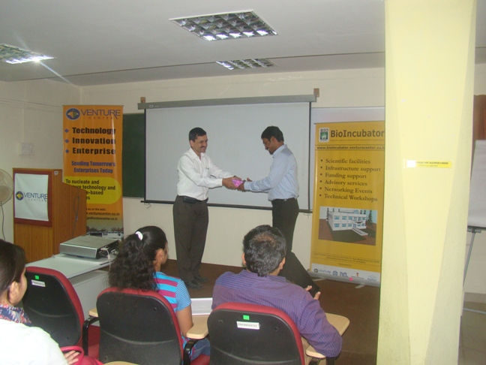
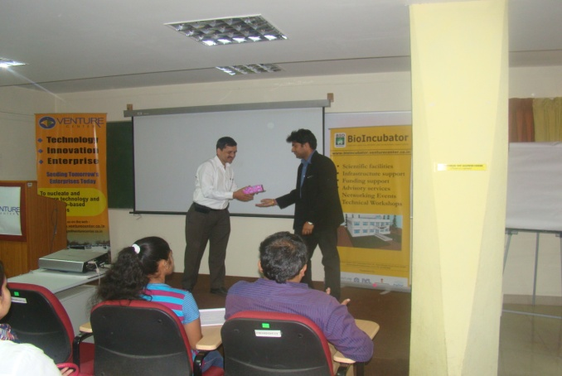
13 May 2015 Half Day Seminar on Regulatory Pathway for Bio-medical Devices and Diagnostics
Speakers
Mr. Praveen Dcruze- Lead scientist with UL India Pvt Ltd.
Mr. Jibu Mathew- Heads the Life &Health Sciences with Underwriters Laboratories India, Bangalore
Mr. Sreenath S- Technical consultant for Medical devices safety and Market access with UL India
Attendees at the seminar: 35

